Slide 1

November 11, 2025

Slide 2


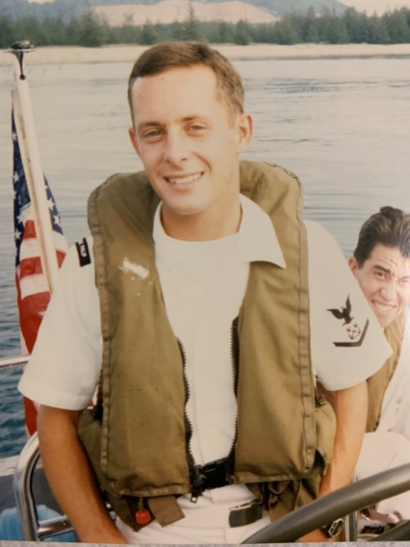


SALUTES OUR VETERANS
JUSTIN DeLUKE
(Fire Dept.)
NAVY
1993-97
11.11.25

Slide 3
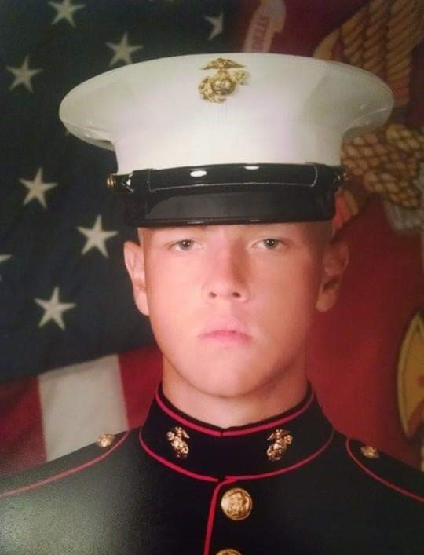

SALUTES OUR VETERANS
ALEXANDER DeHOFF
(Police Dept.)
MARINE CORPS
2014-2018
11.11.25

Slide 4
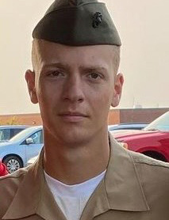
SALUTES OUR VETERANS
CADEN GILLILAND
(Police Dept.)
MARINE CORPS
2020 - 2024
11.11.25

Slide 5

SALUTES OUR VETERANS
GARY JAROSZ
(Engineering Dept.)
ARMY
1987-90
11.11.25

Slide 6
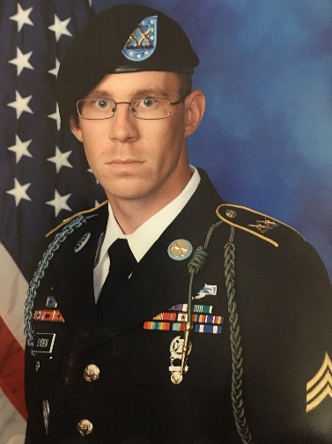
SALUTES OUR VETERANS
STEVEN LYDEN
(Police Dept.)
ARMY 2010 - 2015
Operation Enduring Freedom (Afghanistan)
Afghanistan Campaign Medal with Campaign Star Combat Infantry Badge, Air Assault Badge,
2 Purple Hearts
11.11.25

Slide 7
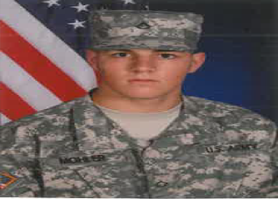

SALUTES OUR VETERANS
ADAM MOHLER
(Police Dept.)
OHIO ARMY
NATIONAL GUARD
2011-2017
11.11.25

Slide 8
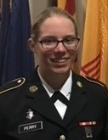
SALUTES OUR VETERANS
EMMA PERRY
(Police Dispatch Dept.)
OHIO ARMY
NATIONAL GUARD
2016-2022
11.11.25

Slide 9
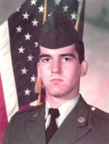

SALUTES OUR VETERANS
BRAD RYCZEK
(Fire Dept.)
ARMY NATIONAL GUARD
1985-1993
11.11.25

Slide 10
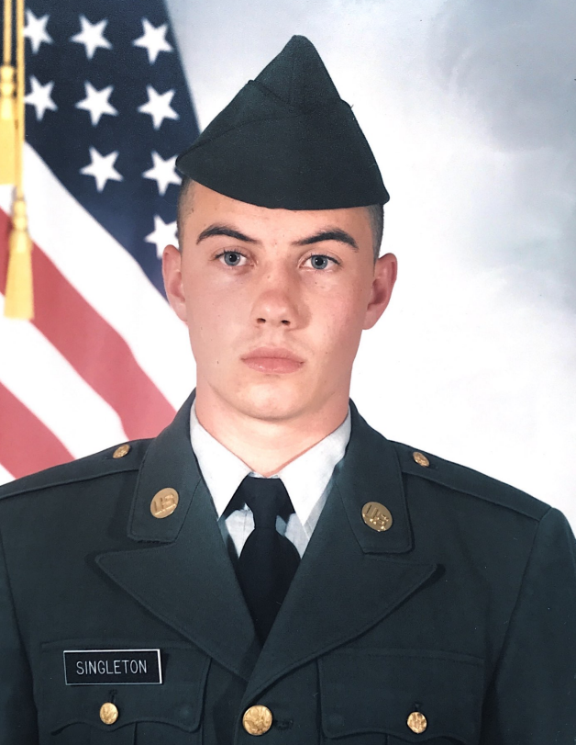
SALUTES OUR VETERANS
CHRIS SINGLETON
(Fire Dept.)
ARMY
1994-2000
11.11.25

Slide 11
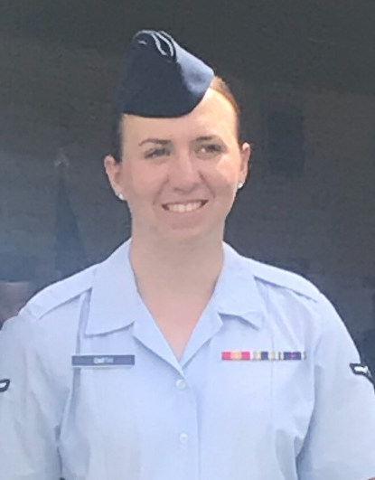

SALUTES OUR VETERANS
ELLIE SMITH
(Police Dept.)
AIR FORCE Reserve
2018 - PRESENT
11.11.25

Slide 12
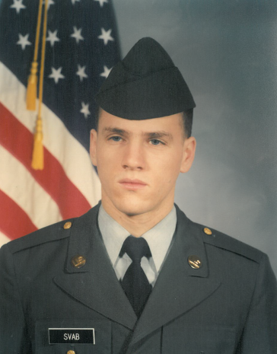
SALUTES OUR VETERANS
DUSTIN SVAB
(Police Dept.)
ARMY 1990-1993
Operation Desert Shield/
Desert Storm
11.11.25

Slide 13
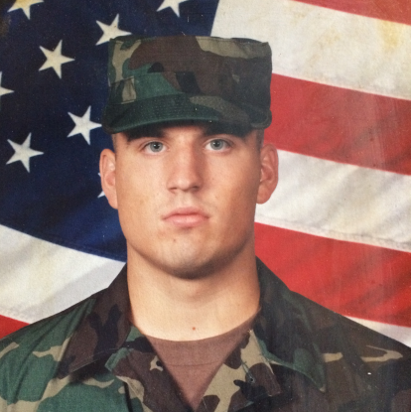
SALUTES OUR VETERANS
ANDREW WERT
(Police Dept.)
ARMY 2003-07, 2009
Combat Deployment OIF 1/2009 - 8/2009
11.11.25

Slide 14



SALUTES OUR VETERANS
JUSTIN DeLUKE, NAVY
ALEXANDER DeHOFF, MARINE CORPS
CADEN GILLILAND, MARINE CORPS
GARY JAROSZ, ARMY
STEVEN LYDEN, ARMY
ADAM MOHLER, OHIO NATIONAL GUARD
EMMA PERRY, OHIO NATIONAL GUARD
BRAD RYCZEK, ARMY NATIONAL GUARD
CHRIS SINGLETON, ARMY
ELLIE SMITH, AIR FORCE
DUSTIN SVAB, ARMY
ANDREW WERT, ARMY
11.11.25
Veterans Day

Slide 15

In honor of all Men and Women who selflessly served Our Country
Thank you for
your service!

